Slide 1


Data Science Project GitHub Metadata Analytics
Cairo University
Faculty of Engineering
Prepared by Team VII
Supervised by Dr. Dina ElReedy

Slide 2
Agenda
0
1
2
Basics
License Prevalence
Language Predictors
3
4
Expected Archivals
Language Successes
5
6
Watchers & Contribution
Generalizing Archival Trends

Slide 3
Agenda
7
8
9
Language Commonality
License, Language and Size
Languages Associations
10
11
Expected Python Contributions
Size & Contribution Effect
12
13
Database & Framework Correspondence
Generalizing Dynamic Typed Languages

Slide 4
Basics
Choosing a technology or programming language is still one of the hardest decisions that have to be made internally in software engineering firms
In this, we consider a data science approach to distinguish different languages
Consider features such as success, collaboration, activity, endangerment, FOSS, etc.
Using variables such as stars, pull requests, commits, archrivals, licenses, etc.

Slide 5
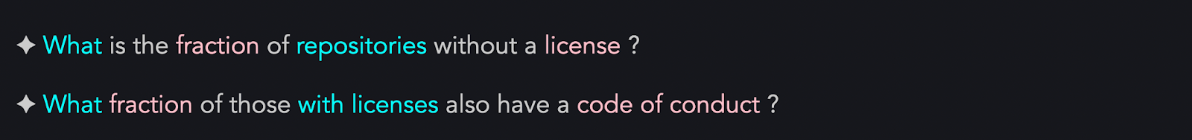
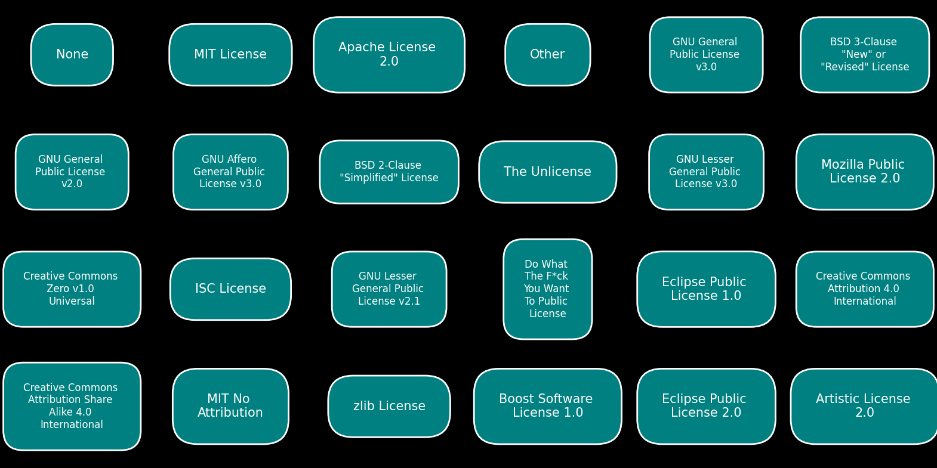
License Prevalence
Present Licenses

Slide 6
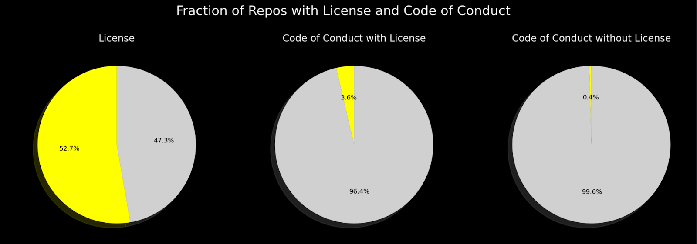
License Prevalence

Slide 7
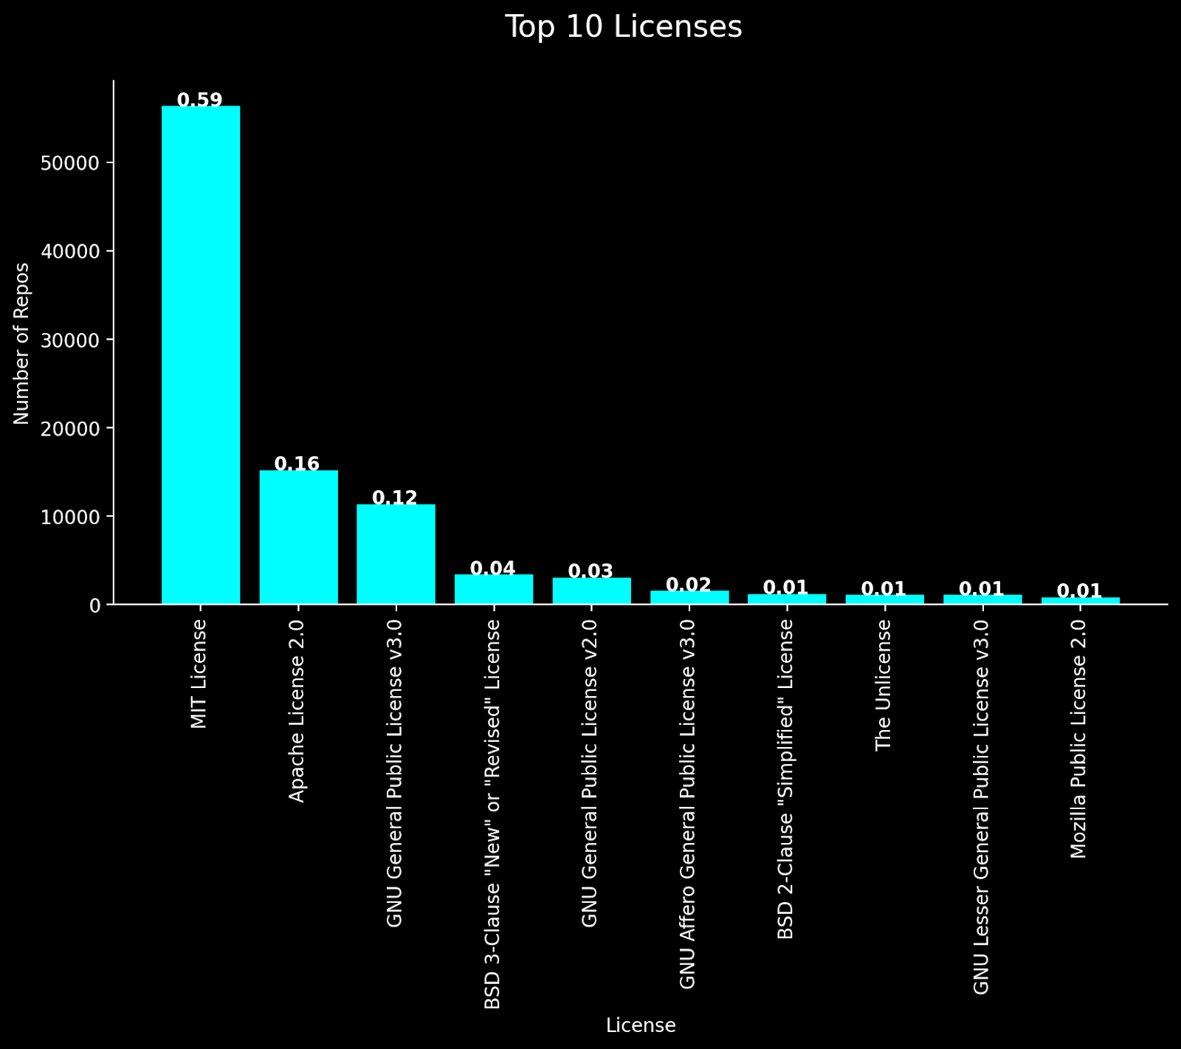
License Prevalence
License Prevalence
✦ Although repos don't require a license by default, about one in every two repos has a license.
✦ On the bright side, the most common ones are the most permissive.
Code of Conduct
✦ The absolute majority of repos do not have a code of conduct; there is no option to add it at the time of repo creation.

Slide 8

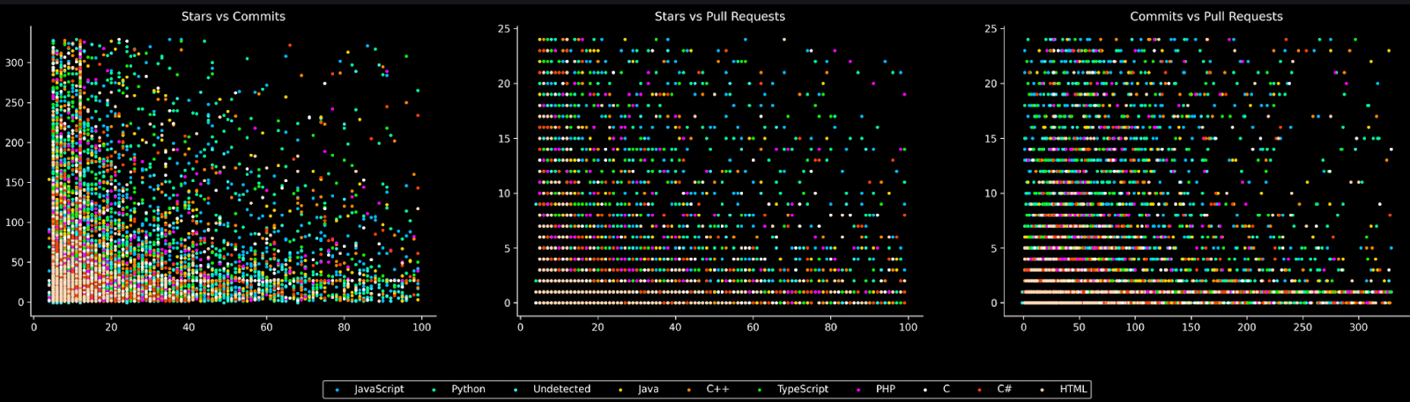
Language Predictors
Looking for a precise distinctive association
Doesn’t exist!

Slide 9
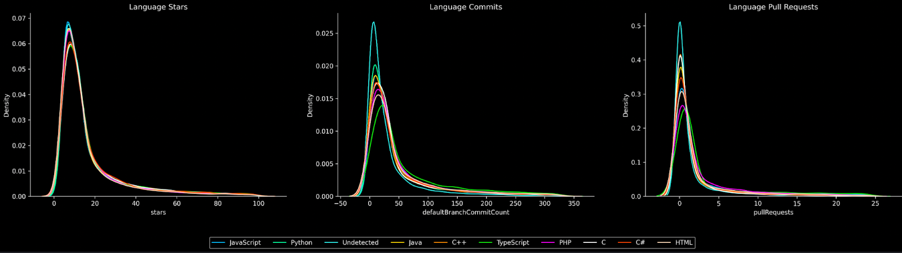
Language Predictors
From a Distribution Perspective
Still doesn’t exist! But there at least a weak association?!

Slide 10
Language Predictors
From a Distribution Perspective
Still doesn’t exist! But there at least a weak association?!

Slide 11
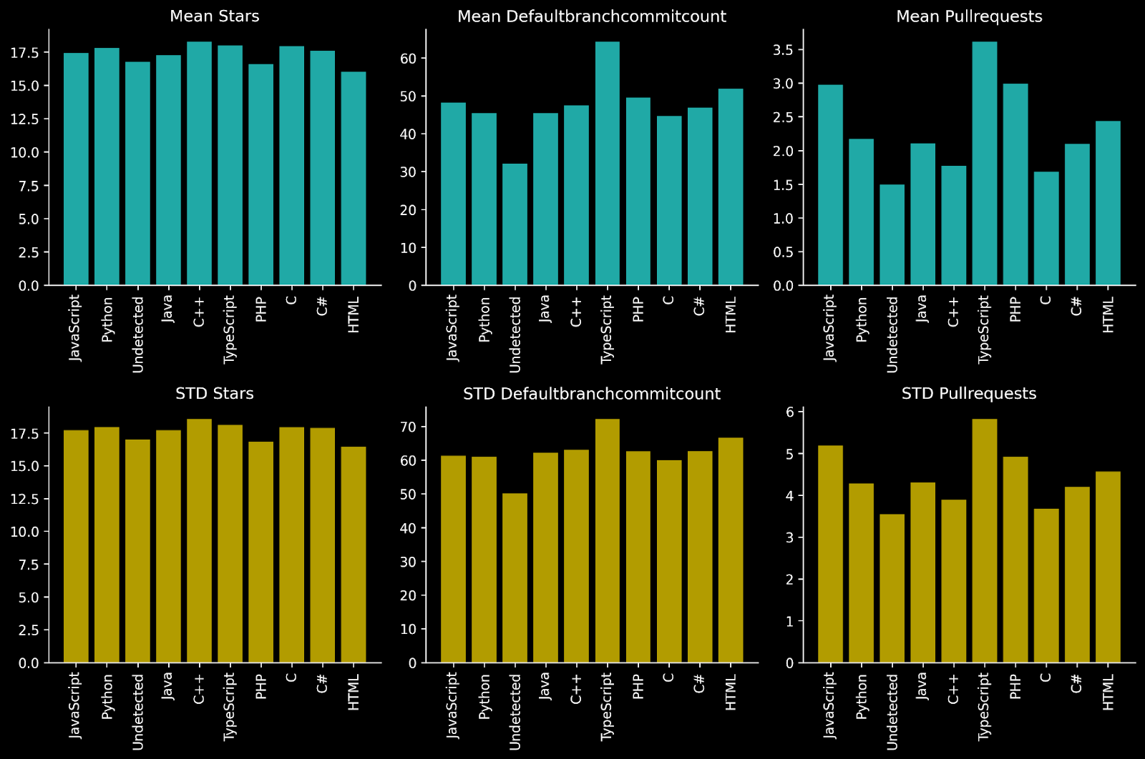
Language Predictors
Still doesn’t exist! But there at least a weak association?!
Look at commits and pull requests.
Yes.
Let’s make claims!

Slide 12
Language Predictors
Still doesn’t exist! But there at least a weak association?!
Let’s make claims!
Stars don’t really different from language to language
TypeScript can be regarded as the most active
C can be regarded as the least collaborative
All statistical tests pass.

Slide 13
Language Predictors
There is no strong or precise association
Languages seem to be equally successful (in terms of stars)
There is a high-level (week) association regarding developer activity
There is a high-level (week) association regarding collaboration

Slide 14

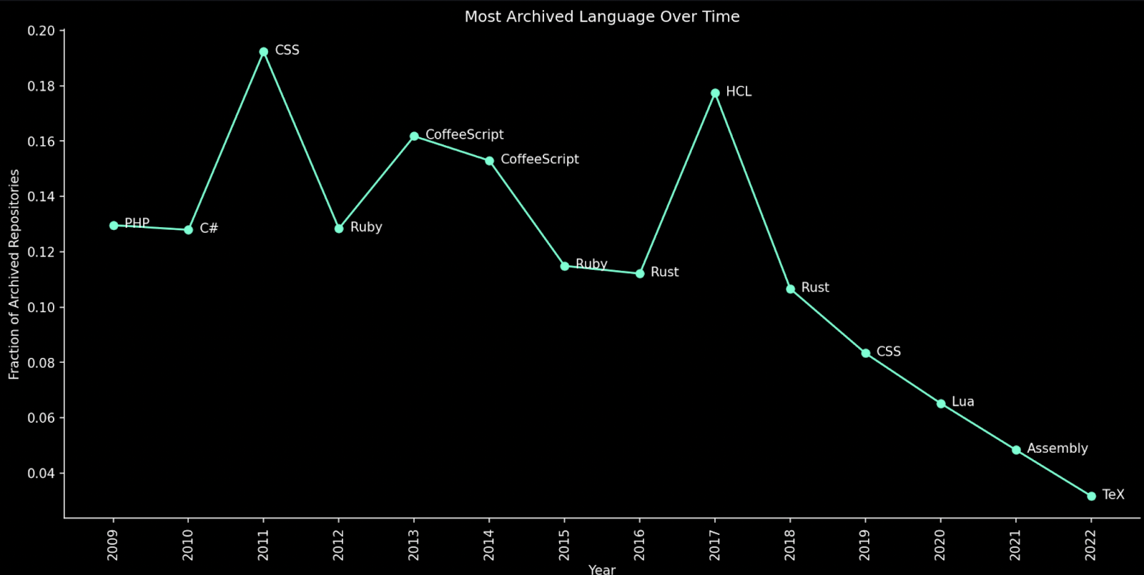
Expected Language Archivals
Begin by Exploring Most Archived Language Every Year

Slide 15
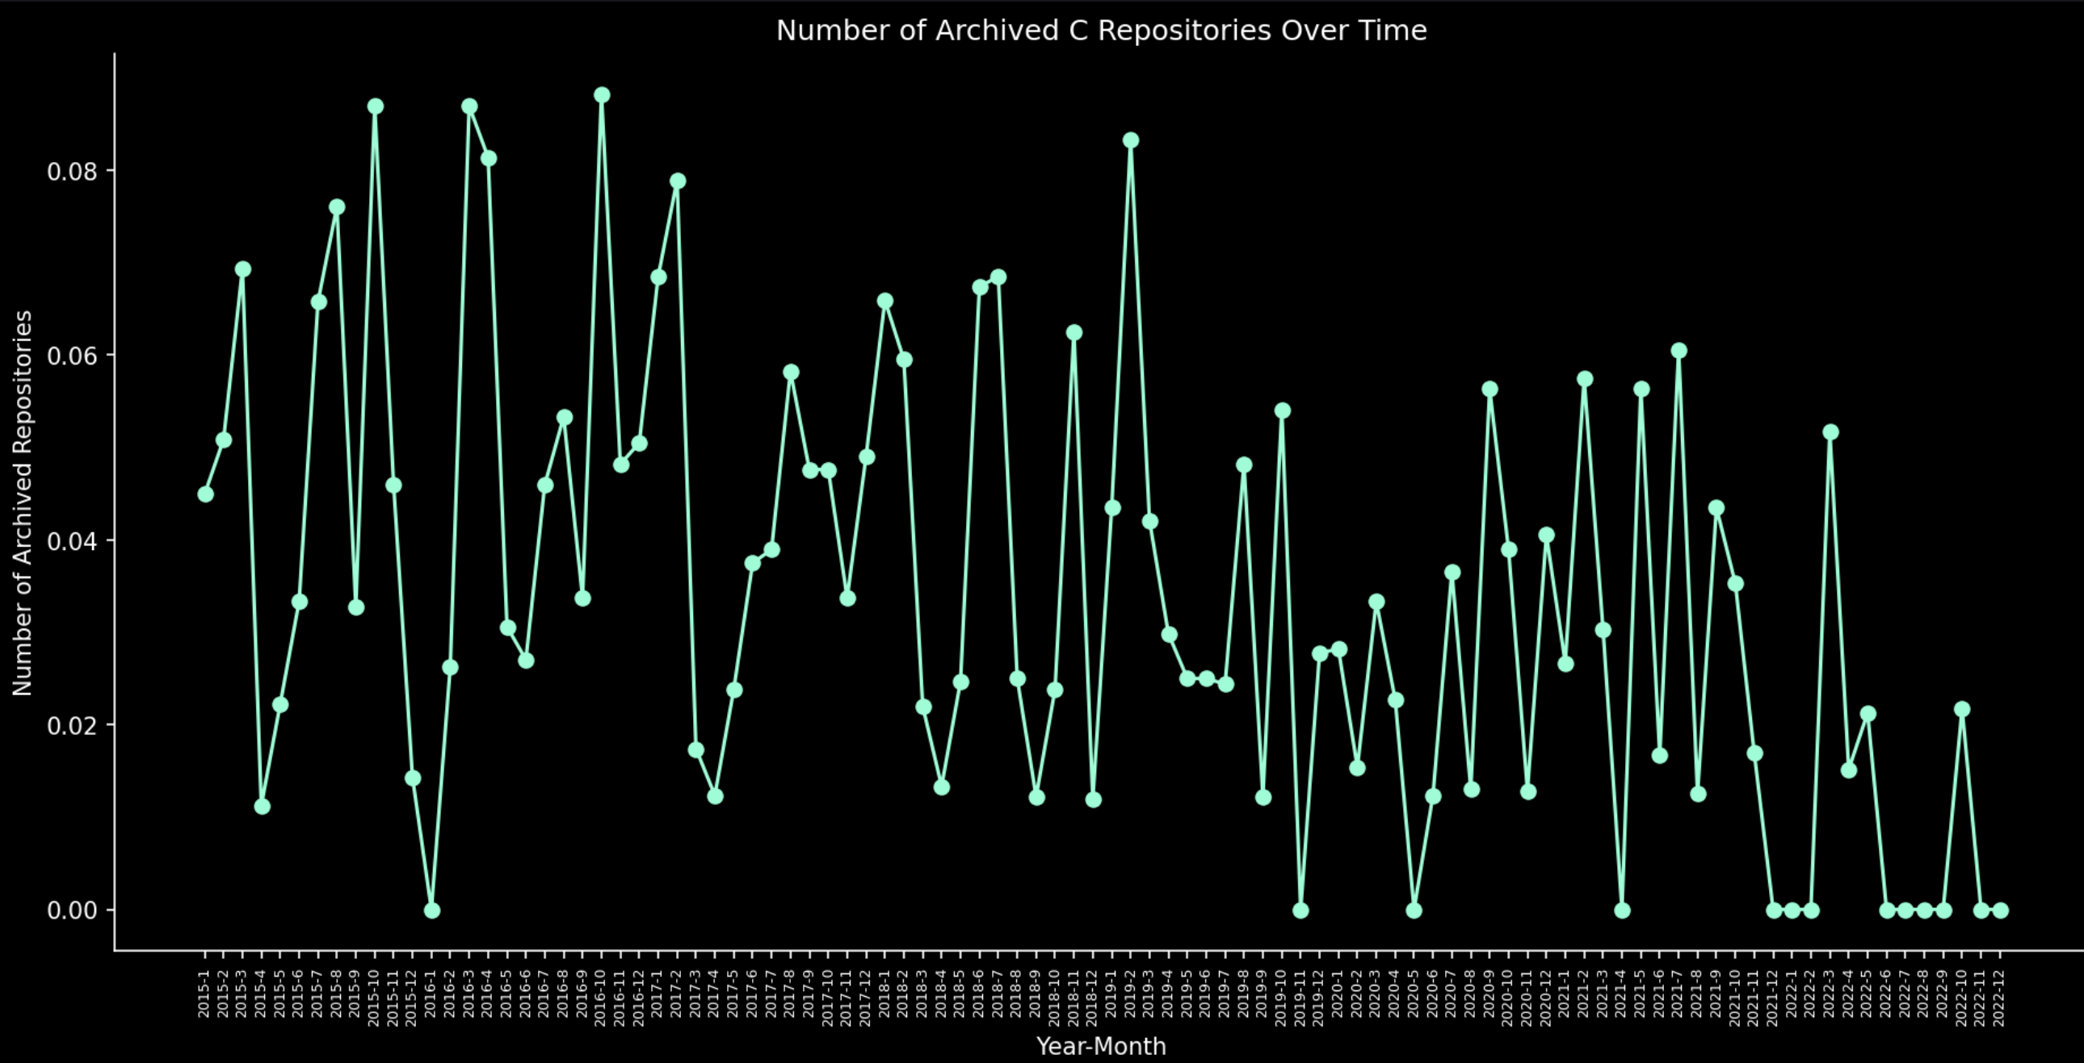
Expected Language Archivals
Can we just assume it will be C?
NO.

Slide 16
Expected Language Archivals
Problem: Too much languages
Solution: Define a Suspect List
Suspect List: All languages with at least 50 repos in 2021 and at least three archivals.
Idea: Now can fit a predictive model for each language in the list.

Slide 17
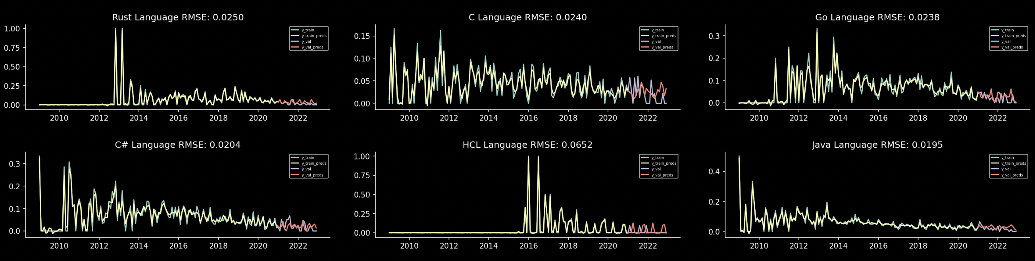
Expected Language Archivals
Example Results

Slide 18
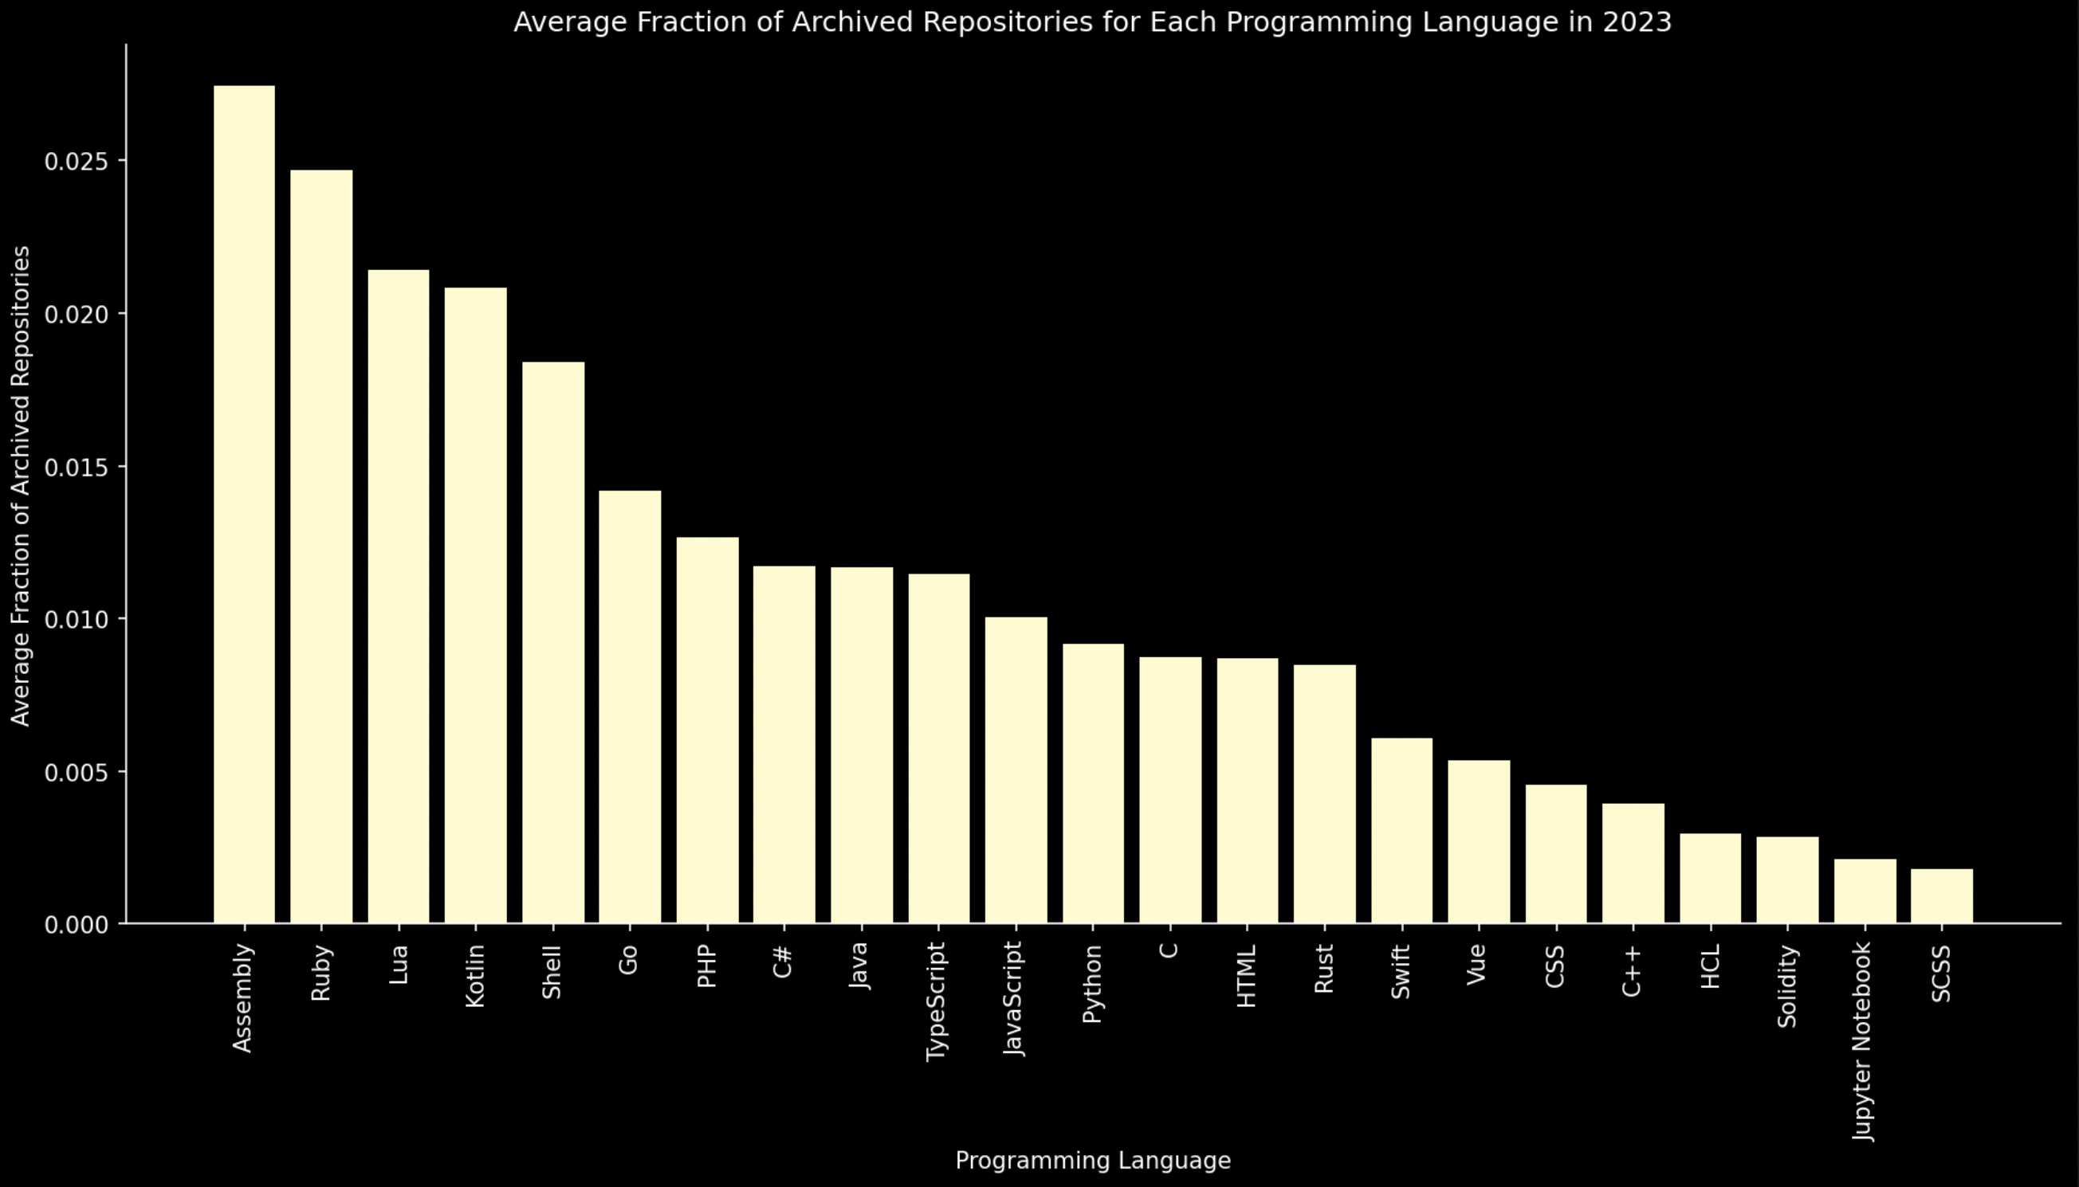
Expected Language Archivals
After Predicting for 2023

Slide 19
Expected Language Archivals
Answer is simply Assembly. In other words, not dead yet. But dying.
C and C++ are still safe; thanks to low-level libraries and OS
Lua and Ruby are at risk of getting endangered

Slide 20
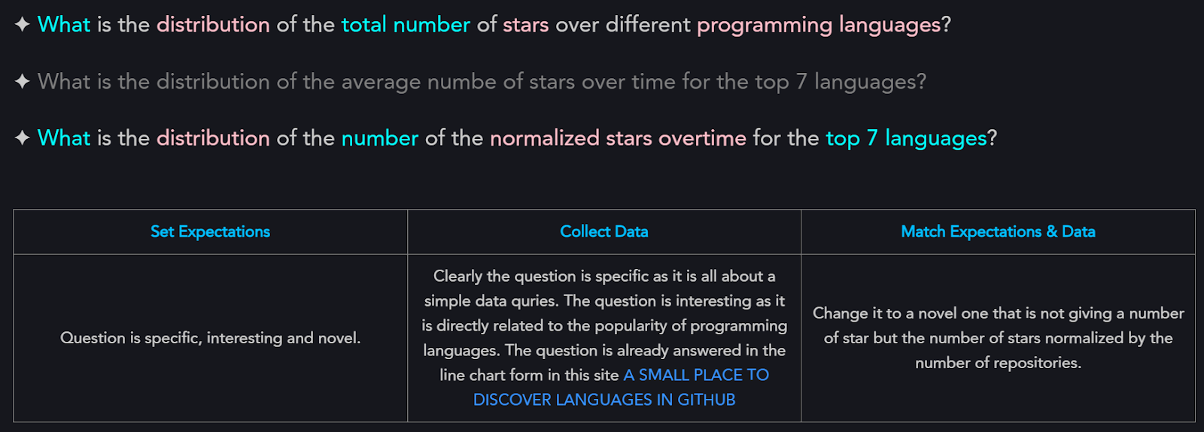
Language Success

Slide 21


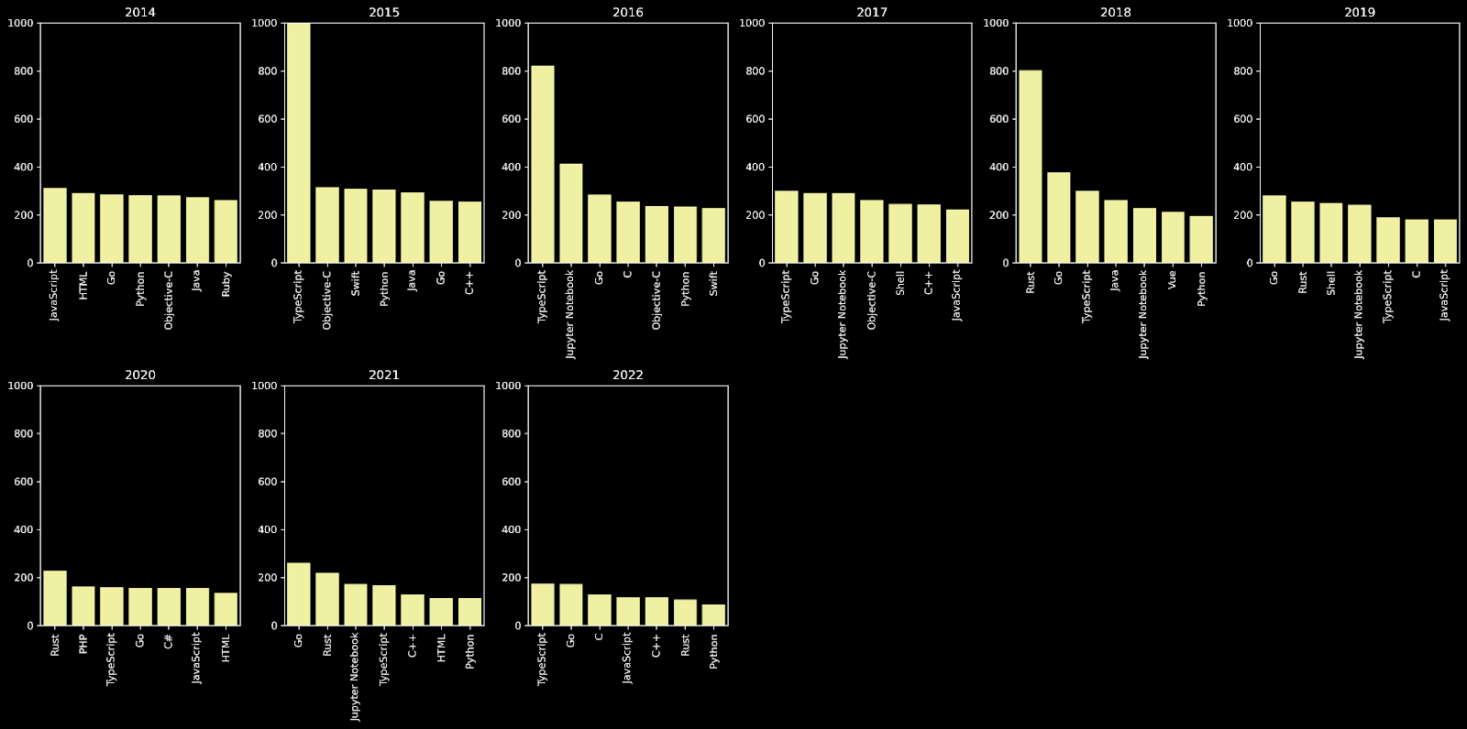
Language Success

Slide 22
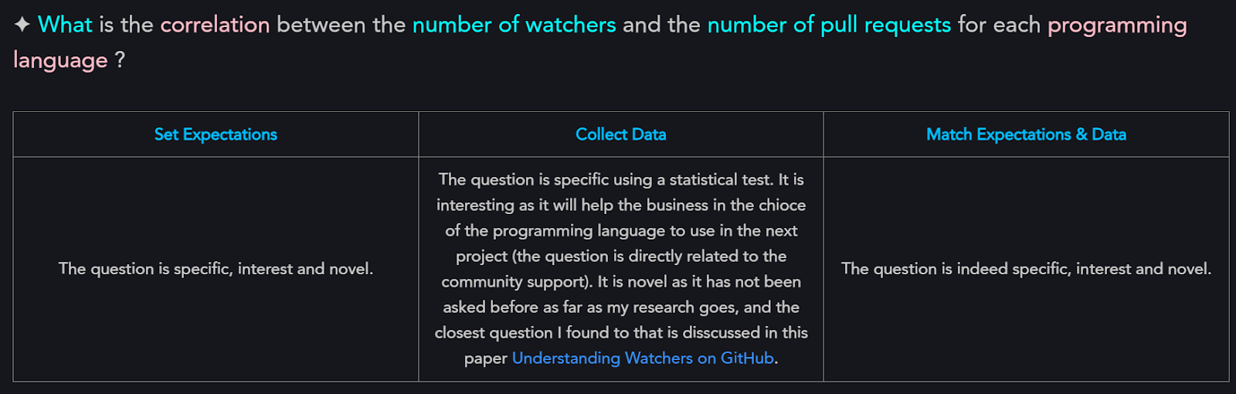
Contribution & Watchers

Slide 23
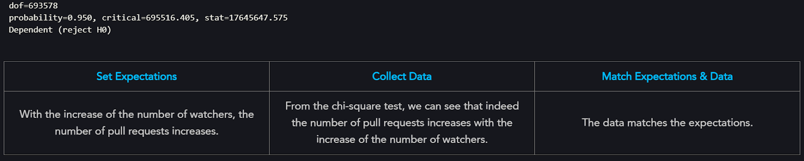
Contribution & Watchers

Slide 24
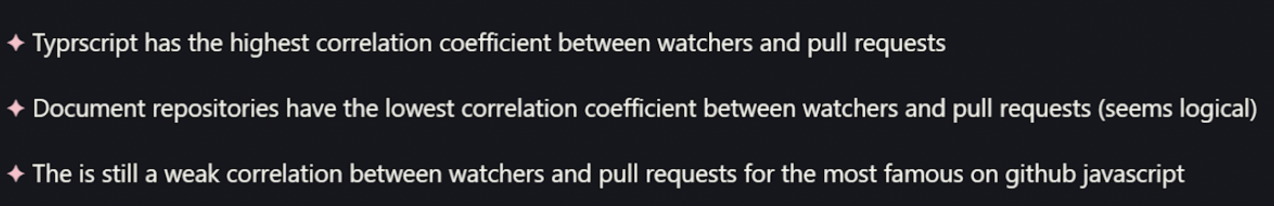
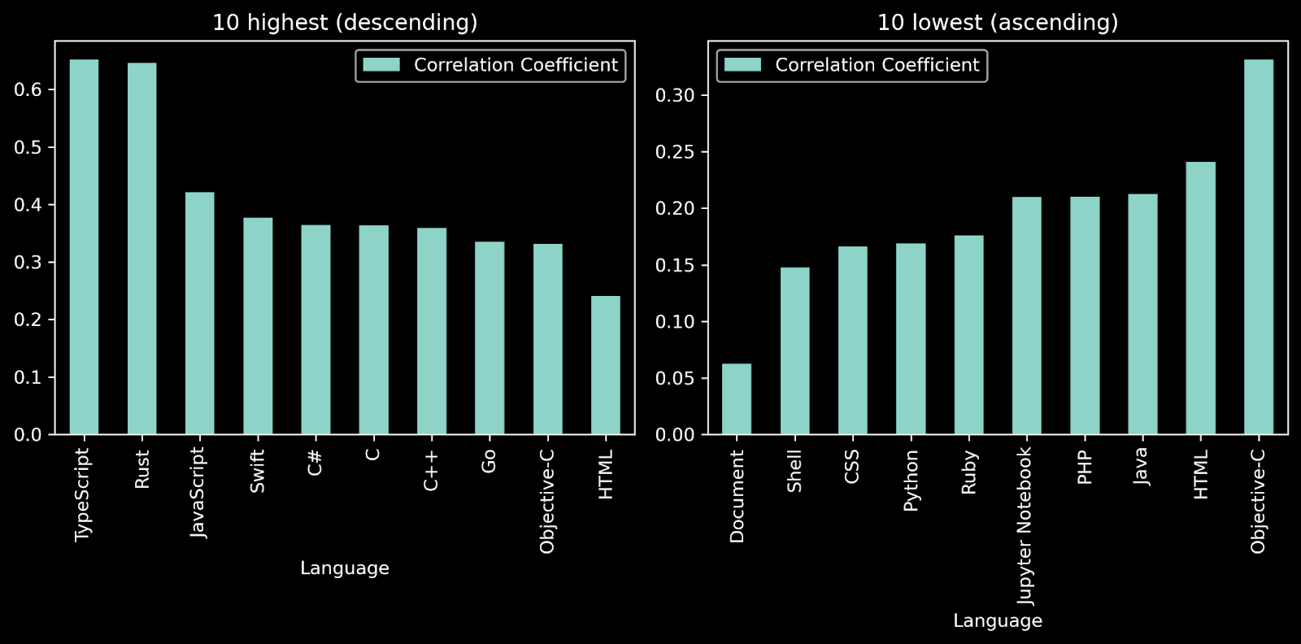
Contribution & Watchers

Slide 25
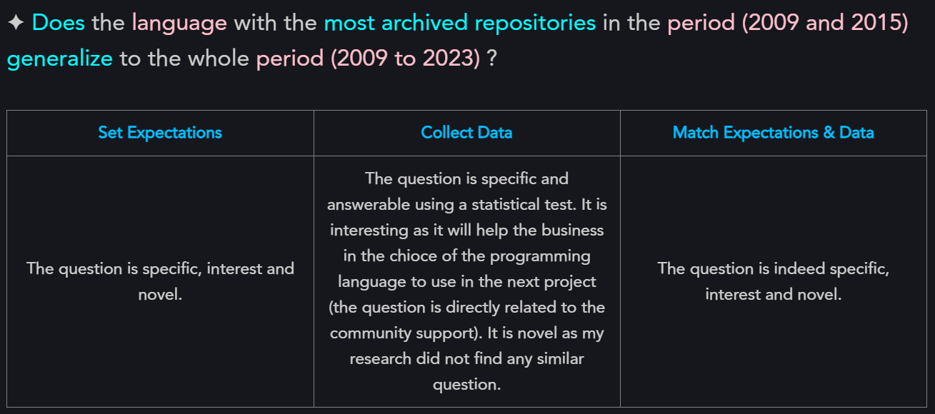
Generalizing Archival Trends

Slide 26

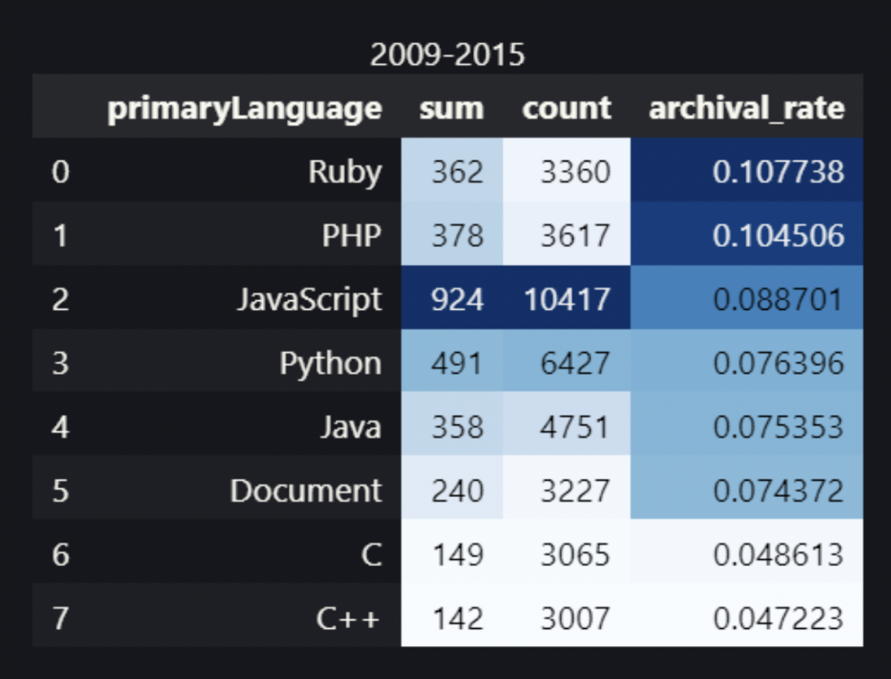
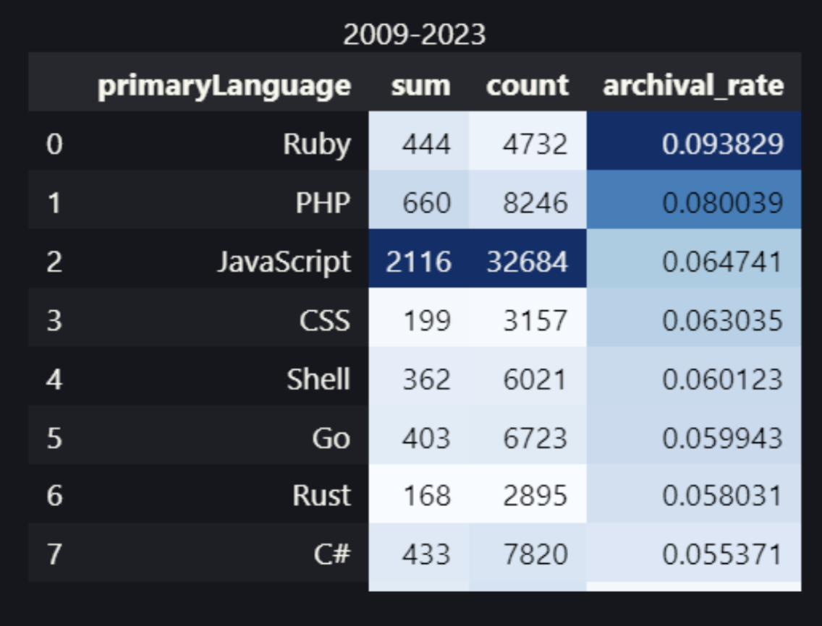
Generalizing Archival Trends
Two proportions z-test

Slide 27
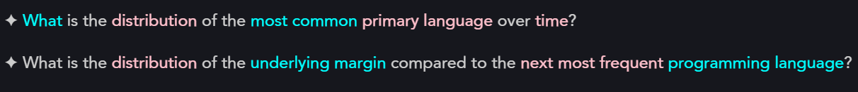
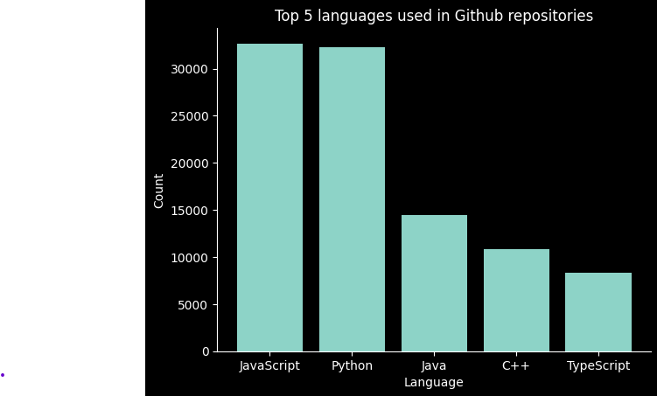
Language Commonality
Most used languages over time

Slide 28

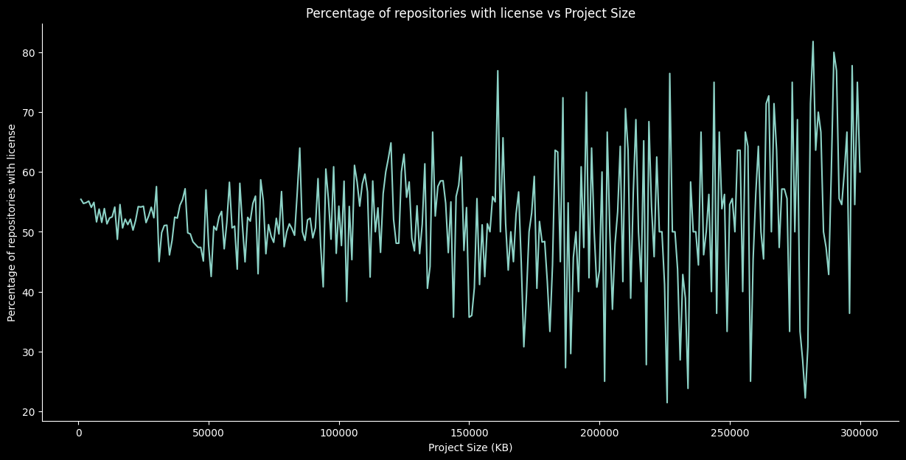
License, Language and Size
Percentage of repositories that have licenses for each project size

Slide 29
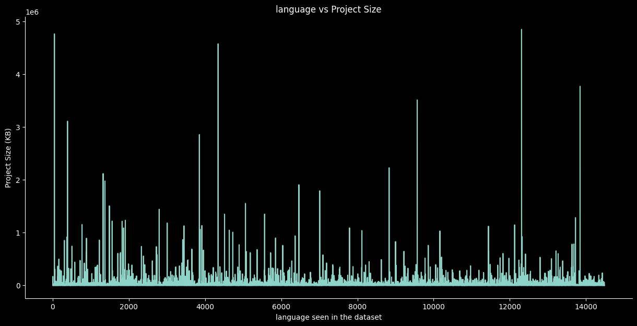
License, Language and Size
Sample language and the project sizes for this language

Slide 30
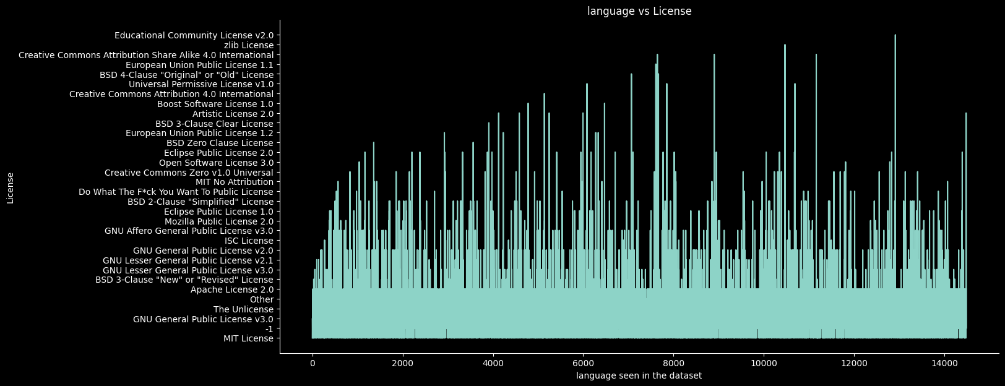
License, Language and Size
Sample language and the used licenses for this language

Slide 31
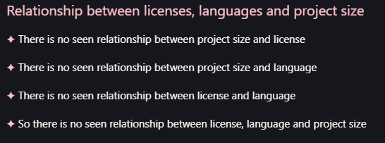
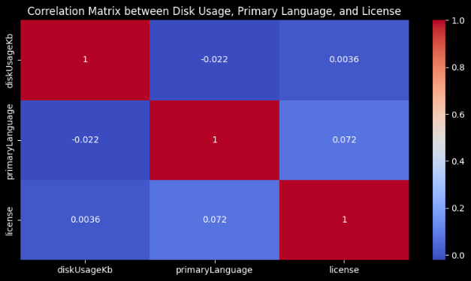
License, Language and Size
Correlation matrix between license, language and size

Slide 32
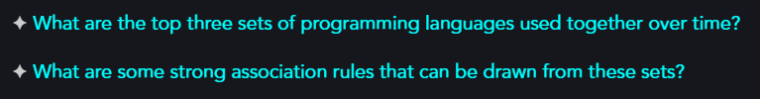
Languages Associations

Slide 33

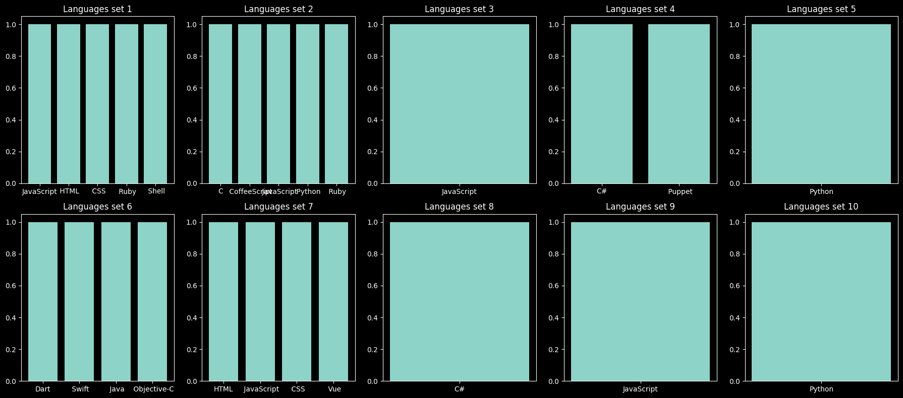
Languages Associations

Slide 34

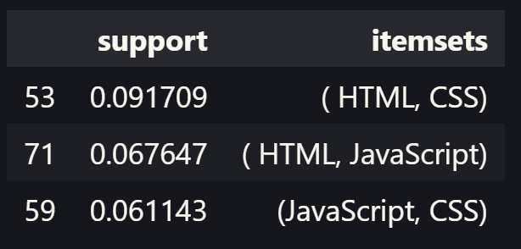
Languages Associations
Top three sets of programming languages used together

Slide 35

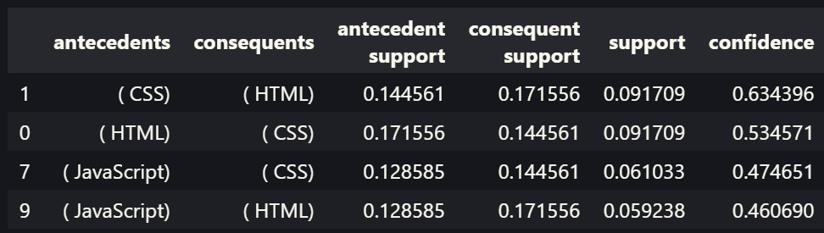
Languages Associations
Top four association rules

Slide 36

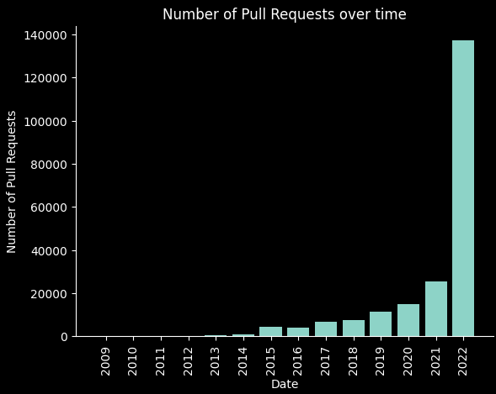
Expected Python Contributions

Slide 37
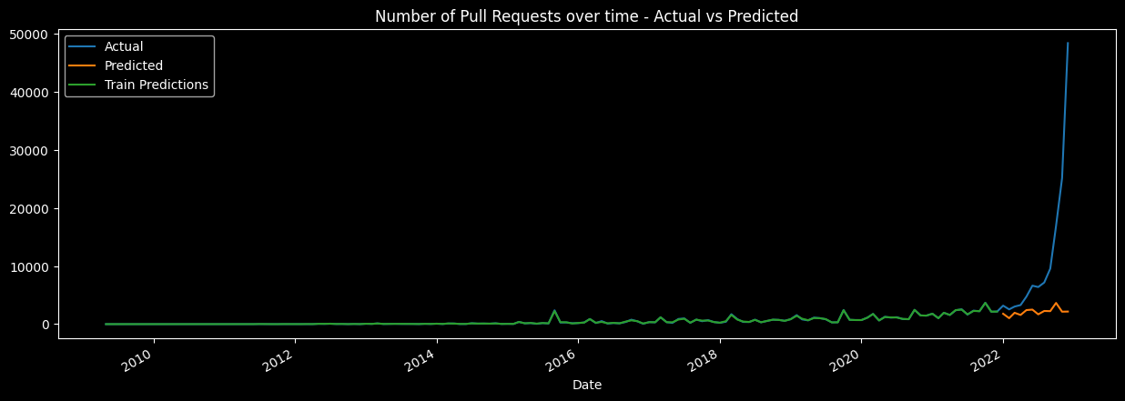
Expected Python Contributions

Slide 38
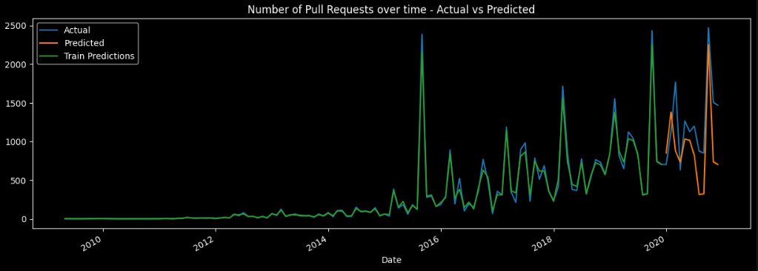
Expected Python Contributions

Slide 39


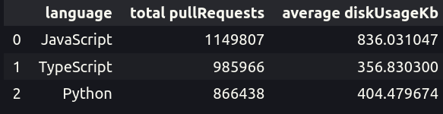
Size & Contribution Effect

Slide 40
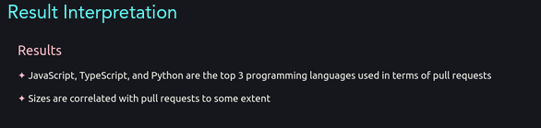
Size & Contribution Effect

Slide 41
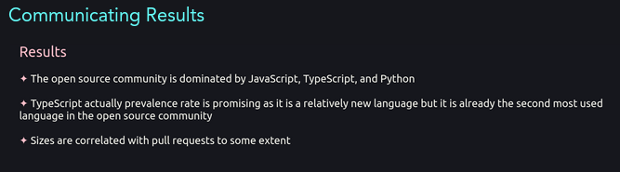
Size & Contribution Effect

Slide 42

Database & Framework Correspondence

Slide 43
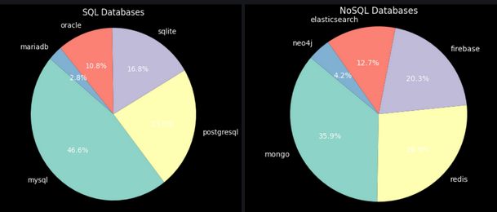
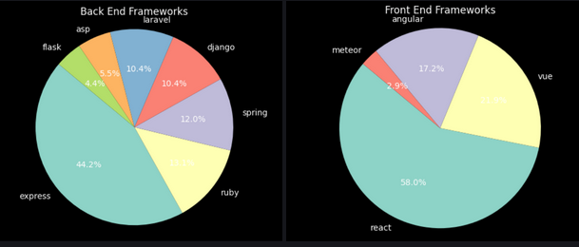
Database & Framework Correspondence
Let’s Explore Our Data

Slide 44

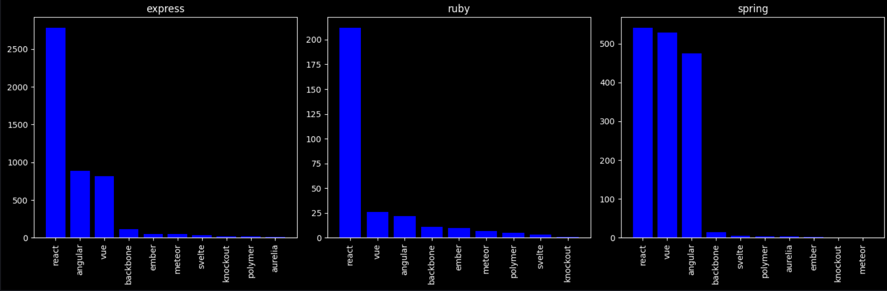
Database & Framework Correspondence
How did we solve it?

Slide 45

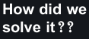
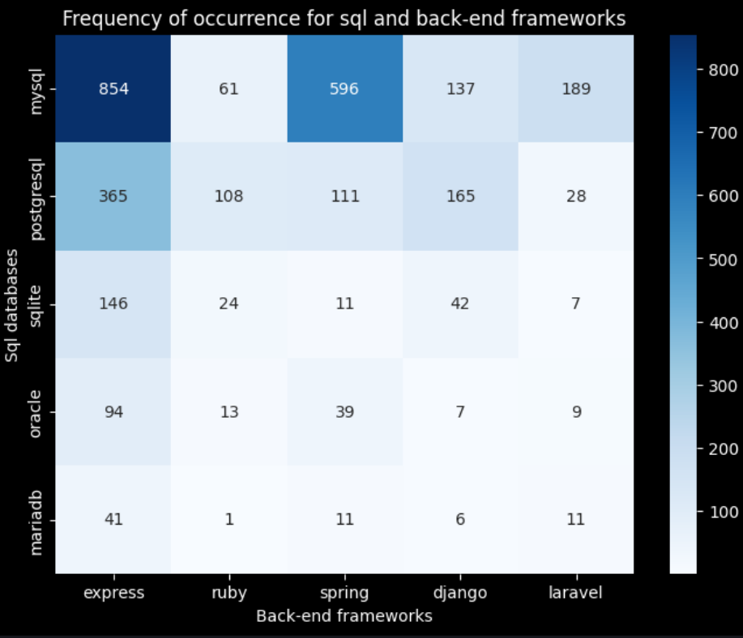
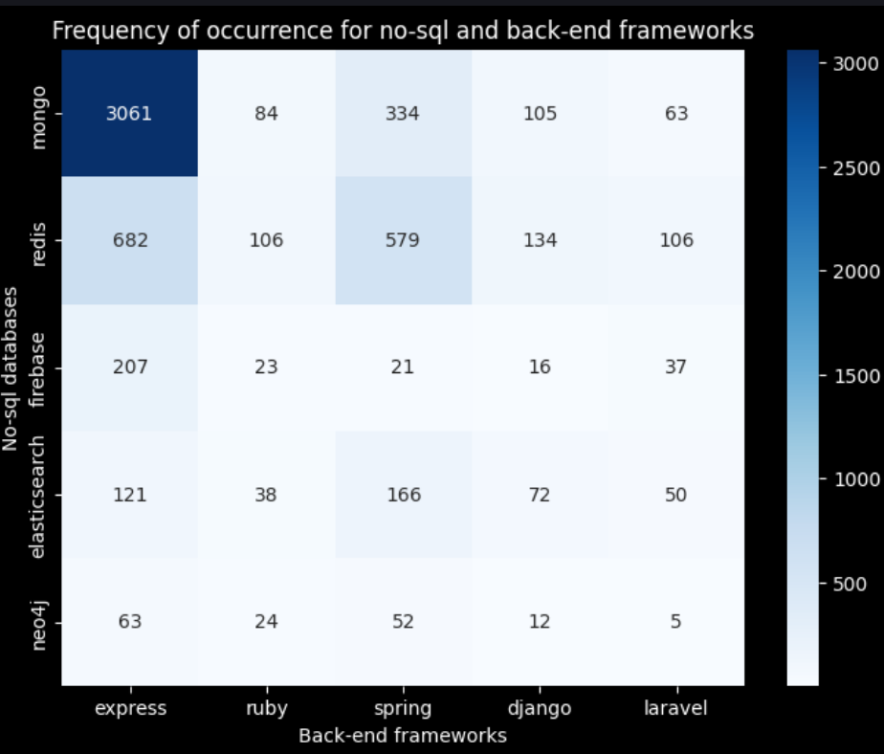
Database & Framework Correspondence

Slide 46

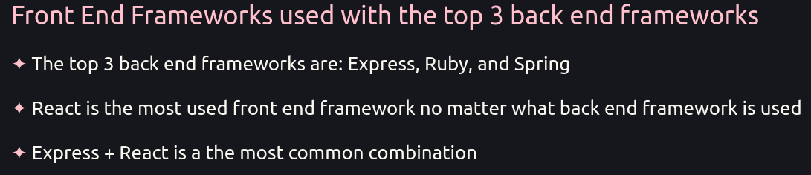
Database & Framework Correspondence

Slide 47
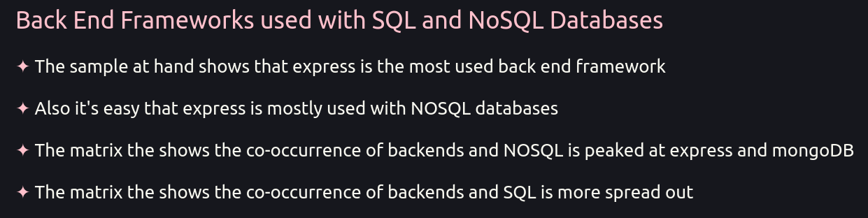
Database & Framework Correspondence

Slide 48
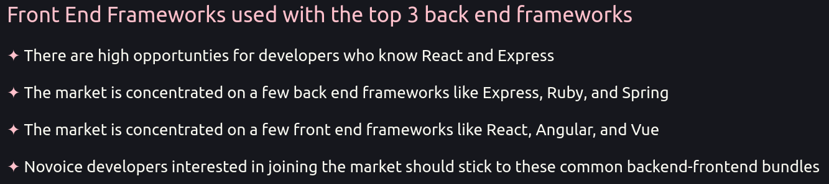
Database & Framework Correspondence
Insights

Slide 49
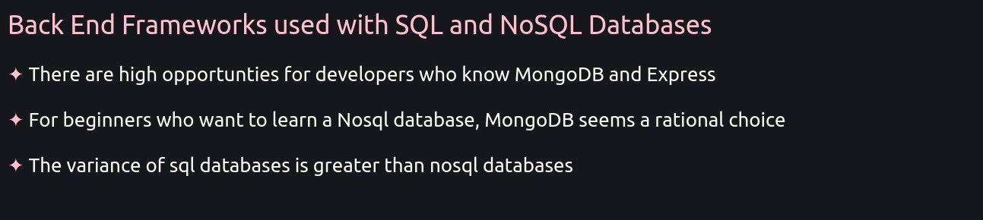
Database & Framework Correspondence
Insights

Slide 50

Generalizing Dynamic Typed Languages

Slide 51

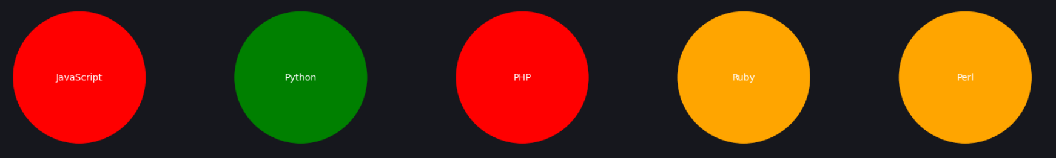
Generalizing Dynamic Typed Languages
Let’s Explore Our Data

Slide 52

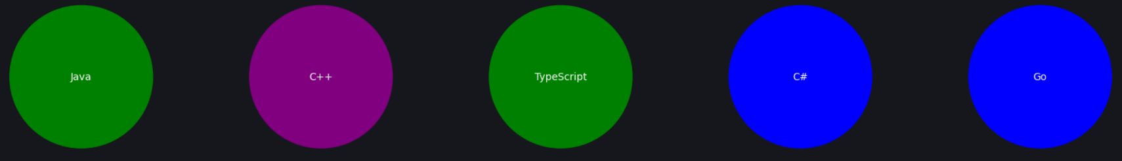
Generalizing Dynamic Typed Languages
Let’s Explore Our Data

Slide 53
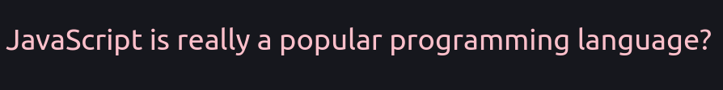

Generalizing Dynamic Typed Languages
YES

Slide 54


Generalizing Dynamic Typed Languages

Slide 55

Generalizing Dynamic Typed Languages

Slide 56
Generalizing Dynamic Typed Languages
Results
Dynamic languages are more popular than static languages and the reason is that they are easier to use and because they appeared as an super cool innovation which prevent the hassle the developers faced at the eariler days of programming specially in the 90s

Slide 57
Generalizing Dynamic Typed Languages
Results
Static typing is increasing in popularity over the years as the world realized the dark side of dynamic languages which is the lack of type checking which leads to many bugs and errors so they started to use more clean and neat languages like Java and C# which are definitely easier than C++ and C

Slide 58

Generalizing Dynamic Typed Languages
Insights

Slide 59

Generalizing Dynamic Typed Languages
Insights
Let’s make a claim!
Dynamically Typed Languages are more popular than Statically Typed Languages!
All statistical tests pass.

Slide 60
Thank You.

